Slide 1
Objectives
In this session, you will learn to:
  Describe the components in a Struts application
  Develop an ActionForm class
  Develop a JSP page for a View form
  Configure the View forms
Notes:
Start the session by explaining the objectives listed in Slide 1. Struts was introduced in session 7. That session only described the controller aspects of Struts. This session describes the view aspects of Struts. In particular, this session covers the action form classes that encapsulate HTML form data and the html tag library from Struts which defines a set of tags that can be used to repopulate form fields.
Code reusability can take many forms. In this session, students are introduced to the concept of presentation component reuse. That is, segments of static or dynamic presentation content are used in a set of complete web pages. These segments promote a consistent look and feel across the whole web application.
Use the following flow in this session:
● Describe the components in a Struts application
● Develop an ActionForm class
● Develop a JSP page for a View form
● Configure the View forms
Exercise 1: Developing a Struts Action Form
Advanced Exercise 2: Using the Struts HTML Tag Library
● Describe how to build web page layouts from reusable presentation components
● Include JSP segments
● Develop layouts using the Struts Tiles framework
Exercise 1: Create a layout page from a template
Exercise 2: Create the tiles pages for the DVD application

Slide 2
Struts Application Components
Struts applications consist of the following:
  Model elements
  View elements
  Control elements
Notes:
Use this slide to explain about the Struts application components. Struts Framework focuses on the Model-View-Controller (MVC) design pattern for the JSP. Model-View-Controller architecture divides the application components into three different categories: Model, View, and Controller.

Slide 3
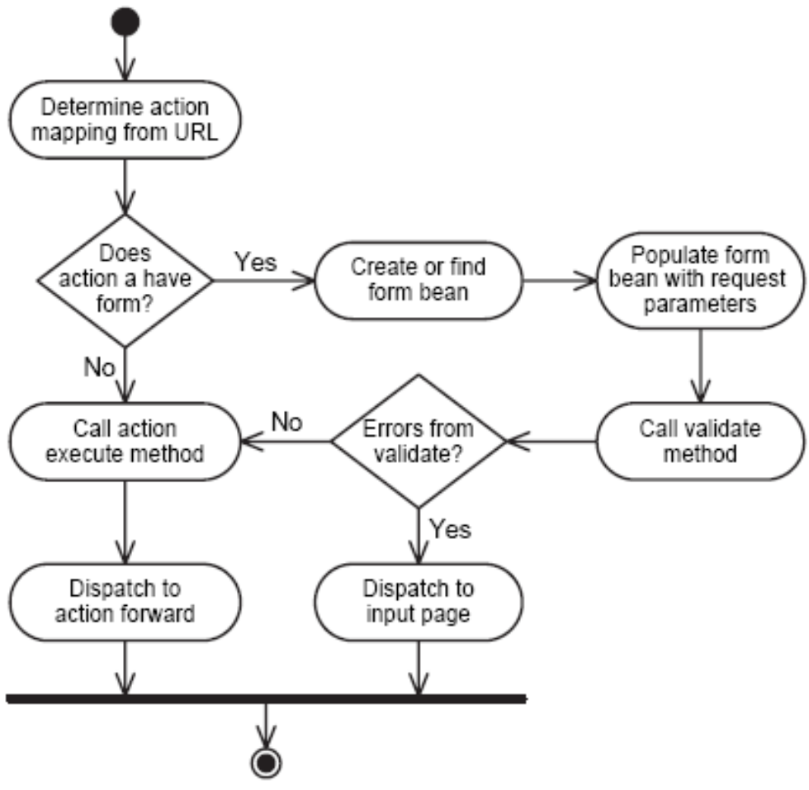
Struts Activity Diagram
Notes:
Use this slide to explain about the Struts activity diagram.

Slide 4
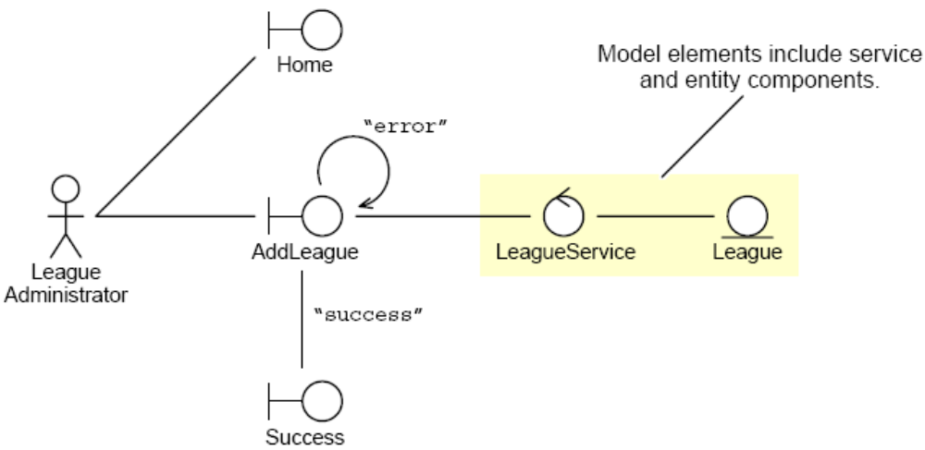
Model Elements Review
Model elements are the service and entity components in the application.
Notes:
Use this slide to explain about the Model elements. Model is responsible for providing data from the database and saving data into the database. All the business logic is implemented in the Model. Model checks the data entered by the user through a View and then saves the data into the database. Model performs operations such as data access, data validation and data saving.

Slide 5
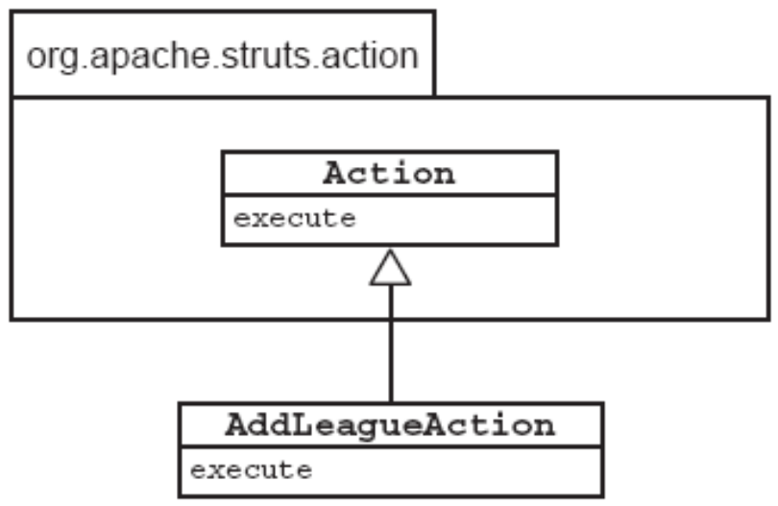
Control Elements Review
The ActionServlet control element is part of the Struts infrastructure
Developers use the Struts subclass Action to create custom action classes
Notes:
Use Slides 5 and 6 to explain about the Control elements. Controller is intermediary between the Model and View components of the MVC architecture. Controller receives request from the client and then executes the appropriate business logic from the Model. Once the execution is complete, it produces the output to the user by using the View component. ActionServlet, Action, ActionForm and struts-config.xml are all part of the Controller component.

Slide 6
Control Elements Review (Contd.)
The Action subclasses are configured in the Struts
configuration file.
  23
  24 <!-- Declare the Registration actions -->
  25 <action path=”/register/select_league”
  26 type=”sl314.controller.SelectLeagueAction”
  27 name=”selectLeagueForm” scope=”request”
  validate=”true”
  28 input=”/register/select_league.jsp” >
  29 <forward name=”success”
  path=”/register/enter_player.jsp”/>
  30 <forward name=”error”
  path=”/register/select_league.jsp”/>
  31 </action>

Slide 7
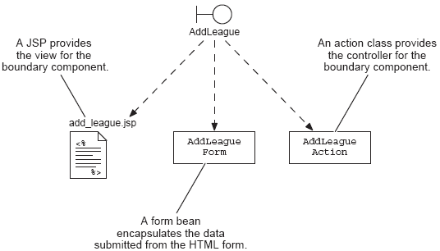
View Elements Review
Views in Struts can have multiple aspects.
Views can be static web pages, dynamic pages (using forms), and ActionForm elements.
Notes:
Use this slide to explain about the View elements. View element represents the user view of the application. View takes input from the user, dispatches the request to the controller and then receives response from the controller and displays the result to the user. HTML, JSPs, Custom Tag Libraries and Resources files are all part of the view component.

Slide 8
Developing an ActionForm Class
ActionForm classes provide an object representation of the elements in an HTML form.
ActionForm classes are automatically created or located by the infrastructure controller.
ActionForm classes are placed into the scope specified in the Struts configuration file.
The form bean is self-validating.
Notes:
Use this slide to develop an ActionForm class. Struts includes an ActionForm abstract class that permits a user to create application-specific form beans that perform all three functions. Separating the Controller code from the View code helps make your application more maintainable.
You might want to mention to students that Struts 1.1 supports DynaActionForms, completely configured within the Struts configuration file. Section 4.3.1 of the Struts User Guide (http://jakarta.apache.org/struts/userGuide/building_controller.html) describes using them when all that the ActionForm is going to do is gather and validate simple form elements.

Slide 9
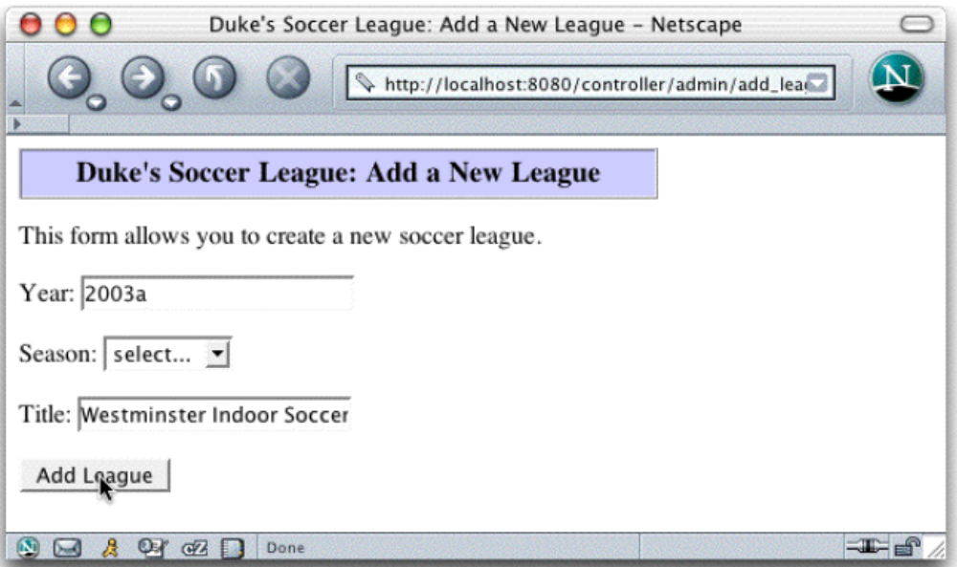
The Add a New League Form
Notes:
Use this slide to explain about the Add a New League form.

Slide 10
The AddLeagueForm Class
1 package sl314.view;
2
3 // Struts imports
4 import org.apache.struts.action.ActionForm;
5 import org.apache.struts.action.ActionMapping;
6 import org.apache.struts.action.ActionError;
7 import org.apache.struts.action.ActionErrors;
8 // Servlet imports
9 import javax.servlet.http.HttpServletRequest;
10
11 /**
12 * This is a Struts form bean for the “Add League” view.
13 */
14 public class AddLeagueForm extends ActionForm {
Notes:
Use Slides 10, 11, 12, 13, and 14 to explain about the AddLeagueForm class.

Slide 11
The AddLeagueForm Class (Contd.)
11 /**
12 * This is a Struts form bean for the “Add League” view.
13 */
14 public class AddLeagueForm extends ActionForm {
15
16 private String season = null;
17 public String getSeason() {
18 return season;
19 }
20 public void setSeason(String season) {
21 this.season = season;
22 }
23
24 private String title = null;
25 public String getTitle() {
26 return title;
27 }
28 public void setTitle(String title) {
29 this.title = title;
30 }

Slide 12
The AddLeagueForm Class (Contd.)
31
32 // The raw ‘year’ property
33 private String yearStr = null;
34 public String getYearStr() {
35 return yearStr;
36 }
37 public void setYearStr(String yearStr) {
38 this.yearStr = yearStr;
39 }
40 // The converted ‘year’ property
41 private int year = -1;
42 public int getYear() {
43 return year;
44 }
45

Slide 13
The AddLeagueForm Class (Contd.)
46 public ActionErrors validate(ActionMapping mapping,
47 HttpServletRequest request){
48 ActionErrors errors = new ActionErrors();
49
50 // Perform data conversions.
51 try {
52 this.year = Integer.parseInt(yearStr);
53 }
catch (NumberFormatException nfe) {
54 errors.add(“yearStr”, new
ActionError(“error.yearField.required”));
55 }
56
57 // Verify form parameters
58 if((year != -1) && ((year < 2000) || (year > 2010))){
59 errors.add(“yearStr”, new
ActionError(“error.yearField.range”));
60 }

Slide 14
The AddLeagueForm Class (Contd.)
61 if ( season.equals(“UNKNOWN”) ) {
62 errors.add(“season”, new
ActionError(“error.seasonField.required”));
63 }
64 if ( title.length() == 0 ) {
65 errors.add(“title”, new
ActionError(“error.titleField.required”));
66 }
67
68 // Return the errors list. An empty list tells Struts
that this form
69 // passed the verification check.
70 return errors;
71 }

Slide 15
Struts ActionError Class
The ActionError objects hold a property key that identifies the application-specific error message.
These error message keys are localed in a resource bundle.
  # Select League fields
  error.seasonField.required=<li>Please select a league season.</li>
  error.yearField.required=<li>The ‘year’ field must be a positive integer.<
The ActionErrors class is a collection of error objects.
This is just one piece of Struts i18n and l10n capabilities.
The JSTL also has a tag library for i18n and l10n support.
Notes:
Use this slide to explain about the Struts ActionError class.

Slide 16
How the Controller Uses the Form Bean
The Action class execute method passes in the form as a generic ActionForm. You must cast the form to your application-specific class.
You can then use the accessor methods on the form bean to access the verified data in the form.
You can remove all of the form verification code in your controller class because the form bean (and Struts) do it for you.
The action classes can also use Struts’ error classes.
Notes:
Use this slide to explain how the controller uses the form bean.

Slide 17
The AddLeagueAction Class
12 // Model classes
13 import sl314.model.LeagueService;
14 import sl314.model.League;
15 import sl314.model.ObjectNotFoundException;
16 // View classes
17 import sl314.view.AddLeagueForm;
18
19
20 public class AddLeagueAction extends Action {
21
22 public ActionForward execute(ActionMapping mapping, ActionForm
form,
23 HttpServletRequest request,
24 HttpServletResponse response) {
25
26 // Use Struts actions to record business processing errors.
27 ActionErrors errors = new ActionErrors();
28 // Store this set in the request scope, in case we need to
29 // send the ErrorPage view.
30 saveErrors(request, errors);
31
Notes:
Use Slides 17, 18, and 19 to explain about the AddLeagueAction class.

Slide 18
The AddLeagueAction Class (Contd.)
26 // Use Struts actions to record business processing errors.
27 ActionErrors errors = new ActionErrors();
28 // Store this set in the request scope, in case we need to
29 // send the ErrorPage view.
30 saveErrors(request, errors);
31
32 try {
33
34 // Cast the form to the application-specific action-form class
35 AddLeagueForm myForm = (AddLeagueForm) form;
36
37 // Perform business logic
38 LeagueService leagueSvc = new LeagueService();
39 League league = leagueSvc.createLeague(myForm.getYear(),
40 myForm.getSeason(),
41 myForm.getTitle());
42 // Store the new league in the request-scope
43 request.setAttribute(“league”, league);
44
45 // Send the Success view
46 return mapping.findForward(“success”);

Slide 19
The AddLeagueAction Class (Contd.)
47
48 // Handle any unusual exceptions
49 } catch (RuntimeException e) {
50
51 // Log stack trace
52 e.printStackTrace(System.err);
53
54 // Record the error
55 errors.add(ActionErrors.GLOBAL_ERROR,
56 new ActionError(“error.unexpectedError”,
57 e.getMessage()));
58
59 // and forward to the error handling page (the form itself)
60 return mapping.findForward(“error”);
61
62 } // END of try-catch block
63
64 } // END of execute method
65
66 } // END of AddLeagueAction class

Slide 20
Developing the JSP Code for a View Form
Struts provides several custom tag libraries for use in JSP pages.
The html tag library has tags that make form development easier.
  Scripting of HTML form components
  Repopulation of form fields is automatic
Notes:
Use this slide to explain about developing the JSP code for a View form.

Slide 21
Struts html Tag Library Overview
These are only some of the tags in the html tag library.
Tag | Purpose
Form | Defines an HTML form
text | Renders a TEXT input element
radio | Renders a radio button input field
submit | Renders a Submit button
image | Renders an image input element
img | Renders an HTML img tag
link | Renders an HTML anchor tag
errors | Displays error messages conditionally
Notes:
Use this slide to explain about the Struts html tag library. The Struts HTML tag library helps create user interfaces easily.

Slide 22
The add_league.jsp Page
1 <%@ page session=”false” %>
2 <%@ taglib prefix=”c”
3 uri=”http://java.sun.com/jsp/jstl/core” %>
4 <%@ taglib prefix=”html”
5 uri=”http://jakarta.apache.org/struts/tags-html” %>
6
7 <%-- Set page title --%>
8 <c:set var=”pageTitle”>Add a New League</c:set>
9
10 <%-- Create business services --%>
11 <jsp:useBean id=”leagueSvc”
class=”sl314.model.LeagueService” />
12
13 <%-- Generate the HTML response --%>
14 <html>
15 <head>
16 <title>Duke’s Soccer League: ${pageTitle}</title>
17 </head>
18 <body bgcolor=’white’>
19
Notes:
Use Slides 22, 23, and 24 to explain about the add_league.jsp page.

Slide 23
The add_league.jsp Page (Contd.)
14 <html>
15 <head>
16 <title>Duke’s Soccer League: ${pageTitle}</title>
17 </head>
18 <body bgcolor=’white’>
19
20 <%-- Generate page heading --%>
21 <!-- Page Heading -->
22 <table border=’1’ cellpadding=’5’ cellspacing=’0’
width=’400’>
23 <tr bgcolor=’#CCCCFF’ align=’center’ valign=’center’
height=’20’>
24 <td><h3>Duke’s Soccer League: ${pageTitle}</h3></td>
25 </tr>
26 </table>
27
28 <%-- Report any errors (if any) --%>
29 <html:errors />
30
31 <%-- Generate main body --%>
32 <p>
33 This form allows you to create a new soccer league.
34 </p>

Slide 24
The add_league.jsp Page (Contd.)
31 <%-- Generate main body --%>
32 <p>
33 This form allows you to create a new soccer league.
34 </p>
35 <html:form action=”/admin/add_league.do” method=”POST”
36 focus=”yearStr”>
37 <%-- Repopulate the year field --%>
38 Year: <html:text property=”yearStr” />
39 <br/><br/>
40 <%-- Repopulate the season drop-down menu --%>
41 Season:
42 <html:select property=’season’>
43 <c:forEach var=”season” items=”${leagueSvc.allSeasons}”>
44 <html:option value=”${season}”>${season}</html:option>
45 </c:forEach>
46 </html:select>
47 <br/><br/>
48 <%-- Repopulate the title field --%>
49 Title: <html:text property=”title” />
50 <br/><br/>
51 <%-- The submit button --%>
52 <html:submit value=”Add League” />
53 </html:form>

Slide 25
Configuring the View Forms
Configure the form beans as follows:
  Form beans are configured in the Struts configuration file.
    10 <form-beans>
    11 <form-bean name=”selectLeagueForm”
    12 type=”sl314.view.SelectLeagueForm” />
    13 <form-bean name=”enterPlayerForm”
    14 type=”sl314.view.EnterPlayerForm” />
    15 <form-bean name=”selectDivForm”
    16 type=”sl314.view.SelectDivisionForm”/>
    17 <form-bean name=”addLeagueForm”
    18 type=”sl314.view.AddLeagueForm” />
    19 </form-beans>
  Form beans are named so that they can be used later within action elements.
Notes:
Use this slide to explain about configuring the View forms.

Slide 26
Configure the View Aspects of the Actions
Action view aspects are also configured in the Struts configuration file.
  49 <!-- Declare the /admin/add_league.do action -->
  50 <action path=”/admin/add_league”
  51 type=”sl314.controller.AddLeagueAction”
  52 name=”addLeagueForm” scope=”request”
  validate=”true”
  53 input=”/admin/add_league.jsp” >
  54 <forward name=”success” path=”/admin/success.jsp”/>
  55 <forward name=”error” path=”/admin/add_league.jsp”/>
  56 </action>
The name, scope, validate, and input attributes are used for this configuration.
Notes:
Use this slide to explain about configuring the View aspects of the Actions.

Slide 27
Demo: Developing Web Applications Using Struts Action Forms
Demo: Developing Web Applications Using Struts Action Forms
Notes:
In this demo, you demonstrate the use of filters in a Web application. You can run the project, Struts2Demo, stored at Datafiles For Faculty\Session19\Demo1\mod13_struts2.zip file in the TIRM CD for demonstration.

Slide 28
Summary
In this session, you learned:
  Struts provides a mechanism to store form data into a JavaBeans instance. This helps separate view processing logic (parameter retrieval, data conversion, data verification) from the controller logic.
  You create a form bean by extending the Struts ActionForm class and providing accessor and mutator methods for each form field.
  You can also perform data conversion within your ActionForm class.
  The validate method lets you perform verification of the form fields.
  The controller classes can access the form bean for this action.
Notes:
End the session by discussing the summary points as given in Slide 28.

